Slide 1
IMPLEMENTATION OF PULSE SHAPING FILTER
R SIDDHARTH
2018504607

Slide 2
SUMMARY
=> PULSE SHAPING
=> NEED FOR PULSE SHAPING
=> PULSE SHAPING FILTERS
=> SINC FILTER
=> RAISED COSINE FILTER
=> CODE

Slide 3
PULSE SHAPING:
Pulse shaping is the process of changing the waveform of transmitted pulse, so that the transmitted signal bandwidth matches the communication channel(Band limited channel).
NEED FOR PULSE SHAPING:
1)To reduce the signal bandwidth,
2)To reduce the Intersymbol Interference(ISI).
01

Slide 4
PULSE SHAPING FILTERS:
Major aspects of wireless communication are
1) Generating bandlimited signals and
2) Reducing inter symbol interference (ISI)
Both requirements can be accomplished by a pulse shaping filter which is applied to each symbol.
INTERSYMBOL INTERFERENCE,it is a form of distortion of a signal, in which one or more symbols interfere with subsequent signals.
02

Slide 5
Not every filter can be used as a pulse shaping filter,it needs to satisfy certain criteria. The Nyquist ISI criterion is a commonly used criterion for evaluation.
Pulse shaping filters that are commonly found in communication systems are,
Sinc shaped filter
Raised-cosine filter
Gaussian filter
Sender side pulse shaping filter is often combined with a receiver side matched filter to achieve optimum tolerance for noise in the system.
03

Slide 6
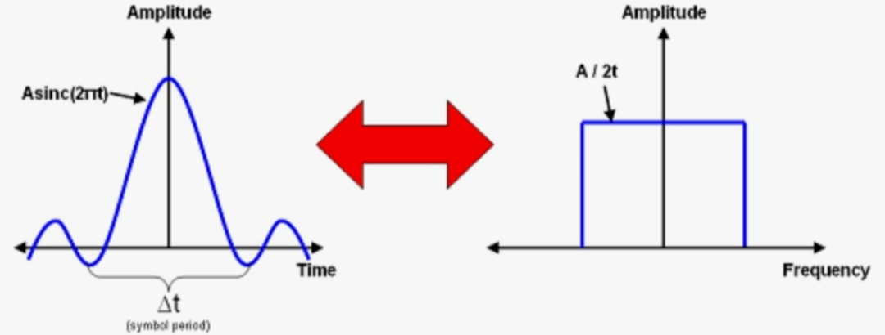
SINC FILTER:
=> Theoretically the best pulse shaping filter would be the sinc filter.
=> The maximum bandwidth is Rb/2 (or) 1/2Tb.
=> But the disadvantage is that it decays slowly at the rate of 1/t.
Thus any error in syncronisation results in significant ISI.
=> Thus to overcome this problem we use Raised cosine filter.
=> Where
Rb=Data Rate
Tb=Symbol Peroiod

Slide 7
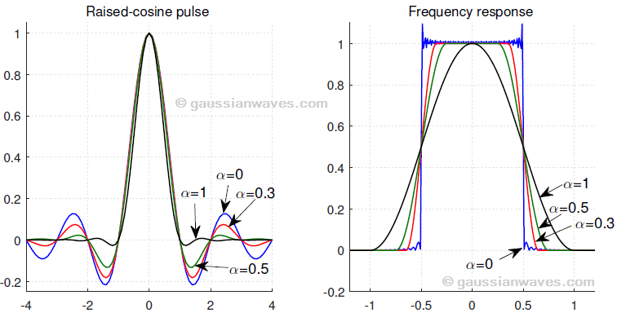
RAISED COSINE FILTER:
=>Raised-cosine is similar to sinc. Raised-cosine filters are practical to implement and they are in wide use.
=>They decay faster when compared to sinc.
=>They have a configurable excess bandwidth by changing a factor called Rolloff factor.
=>Rolloff factor is the percentage increase in bandwidth.
=> It has a maximim bandwidth of Rb (or) 1/Tb.

Slide 8
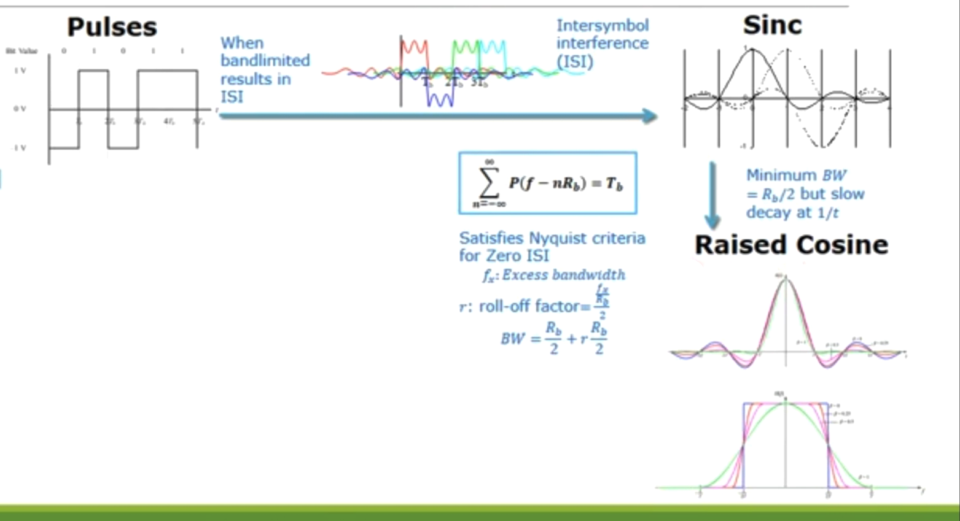
OVERVIEW OF PULSE SHAPING:
05

Slide 9
CODE USING SINC FUNCTION:
clc;
clear all;
close all;
pkg load communications;
rolloff=0.25;
rolloff1=1;
span=6;
sps=4;
d=2*randi([0 1],100,1)-1;
%using sinc function
s=sinc(d);
CODE USING RAISED COSINE:
%with rolloff=0.25
a=rcosdesign(rolloff,span,sps);
b=upfirdn(d,a,sps);
c=b+randn(size(b))*0.01;
e=upfirdn(c,a,1,sps);
%with rolloff1=1
x=rcosdesign(rolloff1,span,sps);
y=upfirdn(d,x,sps);
z=y+randn(size(y))*0.01;
w=upfirdn(z,x,1,sps);
06

Slide 10
PLOTTING SECTION:
figure(1);
subplot(3,2,1);
plot(d);
xlabel(‘time’);
ylabel('amplitude');
title('input data without noise');
subplot(3,2,2);
plot(c);
xlabel(‘time’);
ylabel('amplitude');
title('input data with noise');
subplot(3,2,3);
plot(e);
xlabel('time');
ylabel('amplitude');
title('received data with rf=0.25');
subplot(3,2,4);
plot(w);
xlabel('time');
ylabel('amplitude');
title('received data with rf=1');
subplot(3,2,5);
plot(s);
xlabel('time');
ylabel('amplitude');
title('received data with sinc');
07

Slide 11
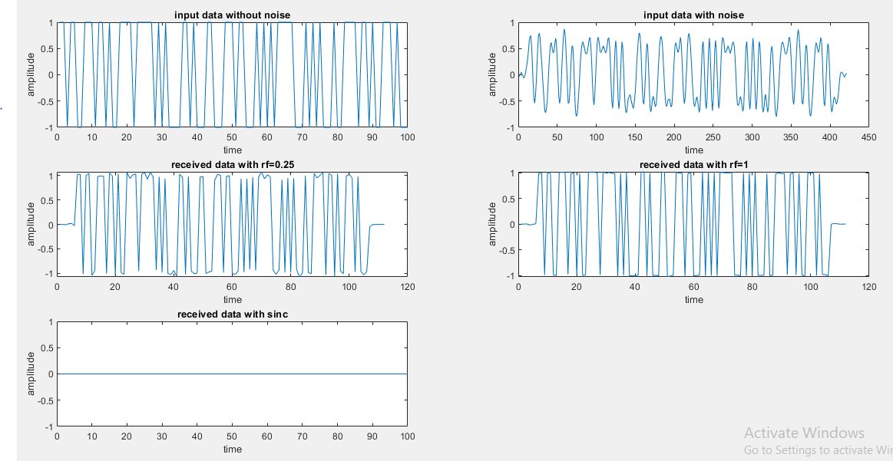
OUTPUT:
08

Slide 12
REFERENCE:
1)https://in.mathworks.com/help/signal/ref/rcosdesign.html
2)https://www.gaussianwaves.com/2018/10/sinc-pulse-shaping/
3)Digital Communication-NPTEL course

Slide 13


Slide 14
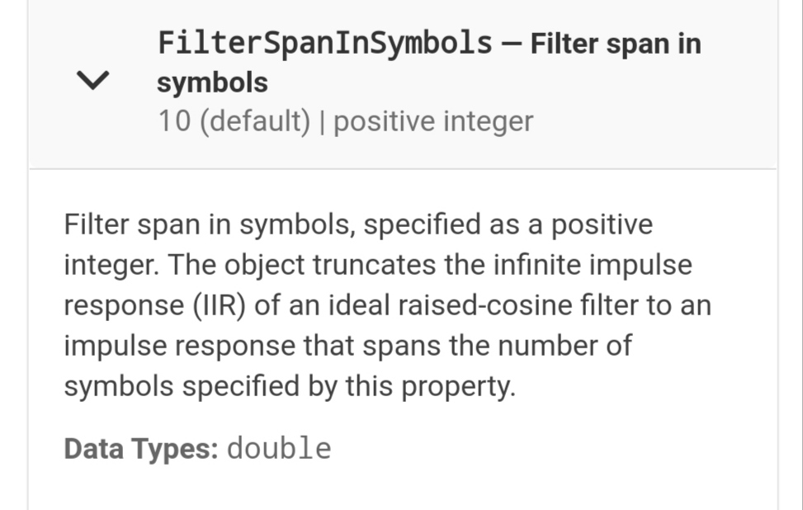
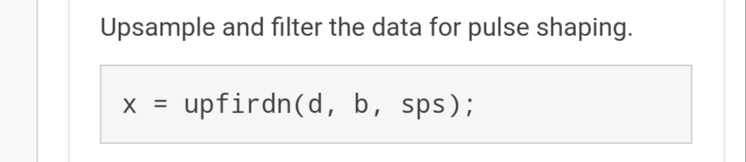
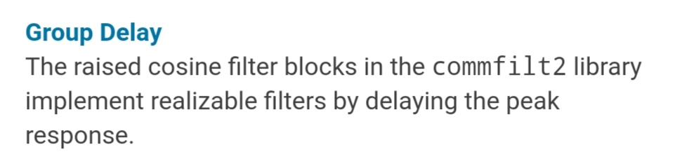
QUESTIONS ASKED:
=>What is a SPAN?
SPAN is the no of symbols used in the filter.
=>Explain upfirdn function?
The function is used to upsample the data and filtering it for pulse shaping.
=>Why the output data is delayed?
The rcosdesign function used in raised cosine filter is from commfilt2 library and it is default that it has a group delay(delaying the peak responses).

